Slide 1

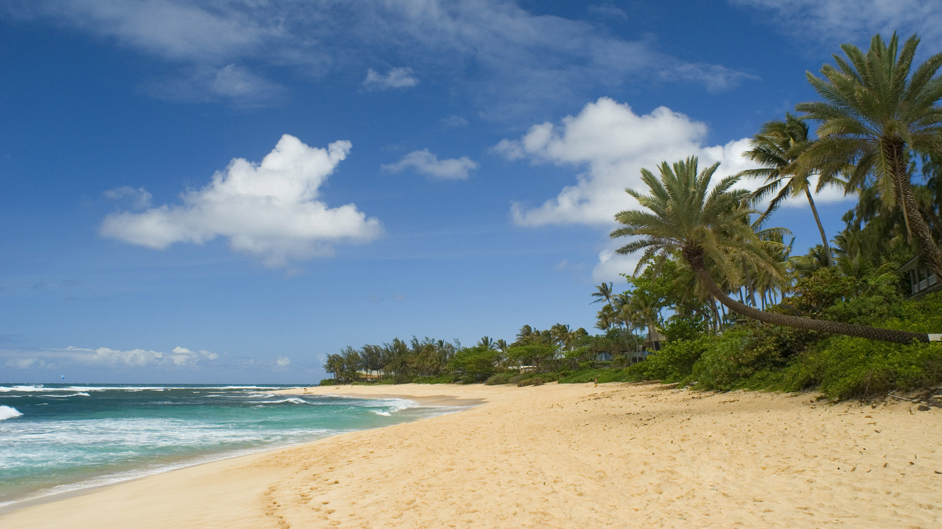
MY DREAM DESTINATION
THE HAWAII ISLAND

Slide 2
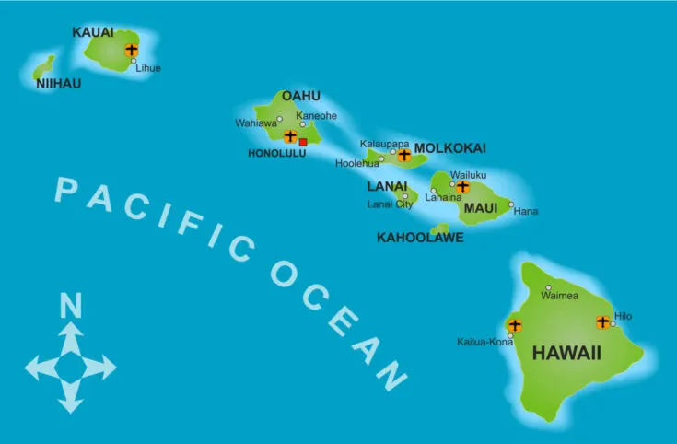

Slide 3

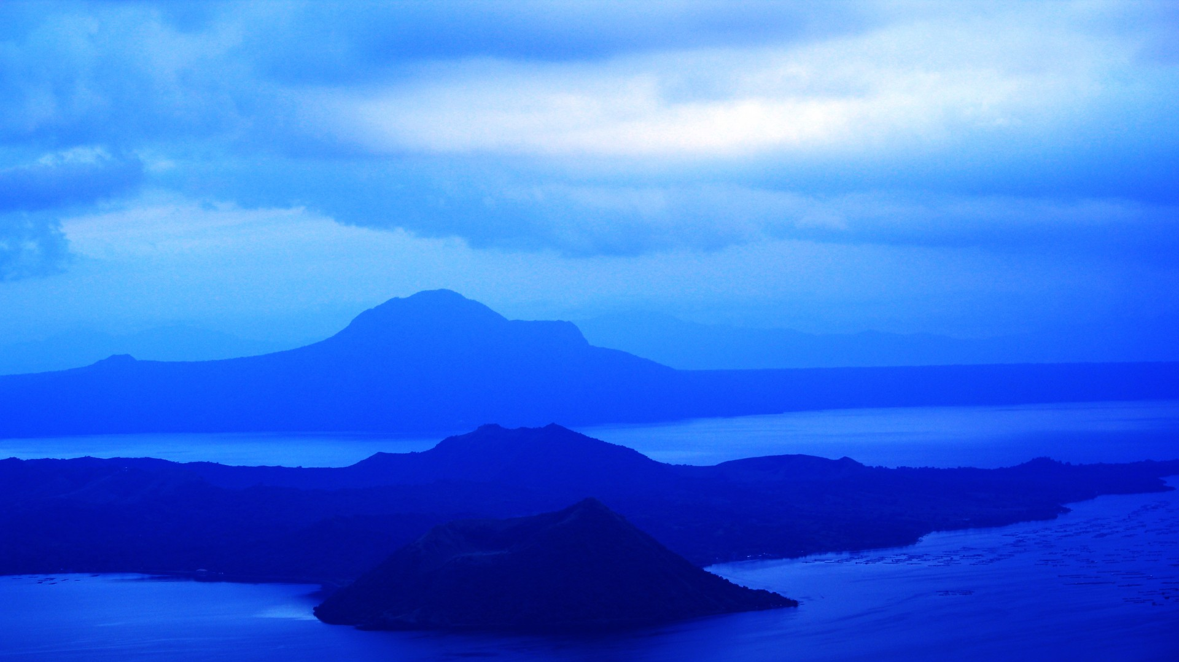
HAWAII is a dream destination for many people around the world. It has it all from deep blue tropical lagoons, beaches white sand, beautiful waterfalls, lush vegetation and serene mountains.

Slide 4
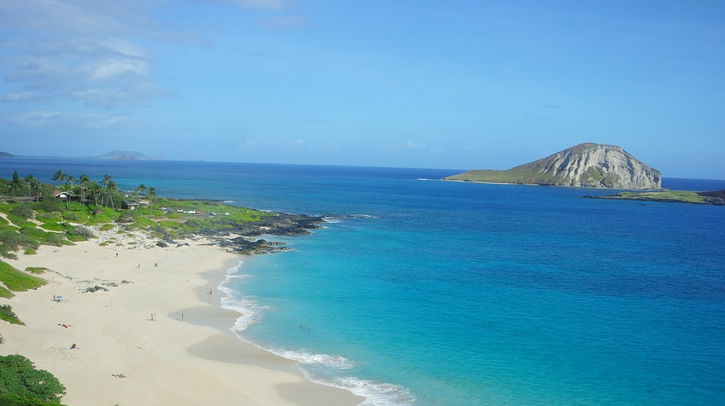

Hawaii sits over 2,000 miles west of California.
It's is the world largest island chain, and it's the only U.S. state completely made up of islands. But only 7 of its 132 islands are inhabited.
There are six main islands Oahu, Kauai, Maui, the Big Island of Hawaii, Molokai and Lanai.
Hawaii is known for its pristine beaches, its laid-back lifestyle, and its delicious food. Some traditional Hawaiian dishes like poi and laulau are very famous there.
The Aloha shirts and Lei (Hawaiian garland) are considered souvenir for tourists. The aloha shirt is now considered formal wear in Hawaii.

Slide 5

KAUAI
The oldest and northern most island in the Hawaiian chain is draped in emerald valleys, sharp mountain spires and jagged cliffs, aged by time and elements.

Slide 6
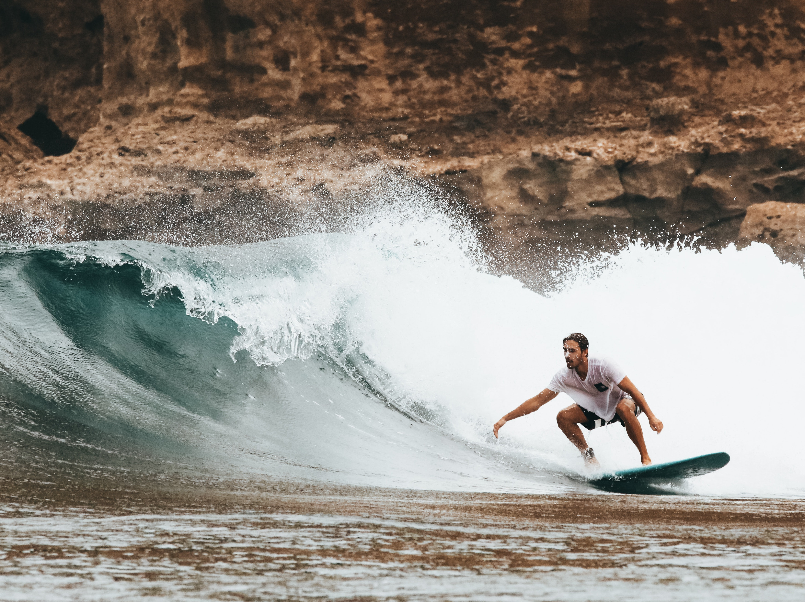
OAHU
Named as "Gathering place", and the most visited Hawaiian Island. Oahu is the home to the majority of Hawaii's diverse population, a fusion of east and west cultures rooted in the values and traditions of the native Hawaiian people.

Slide 7
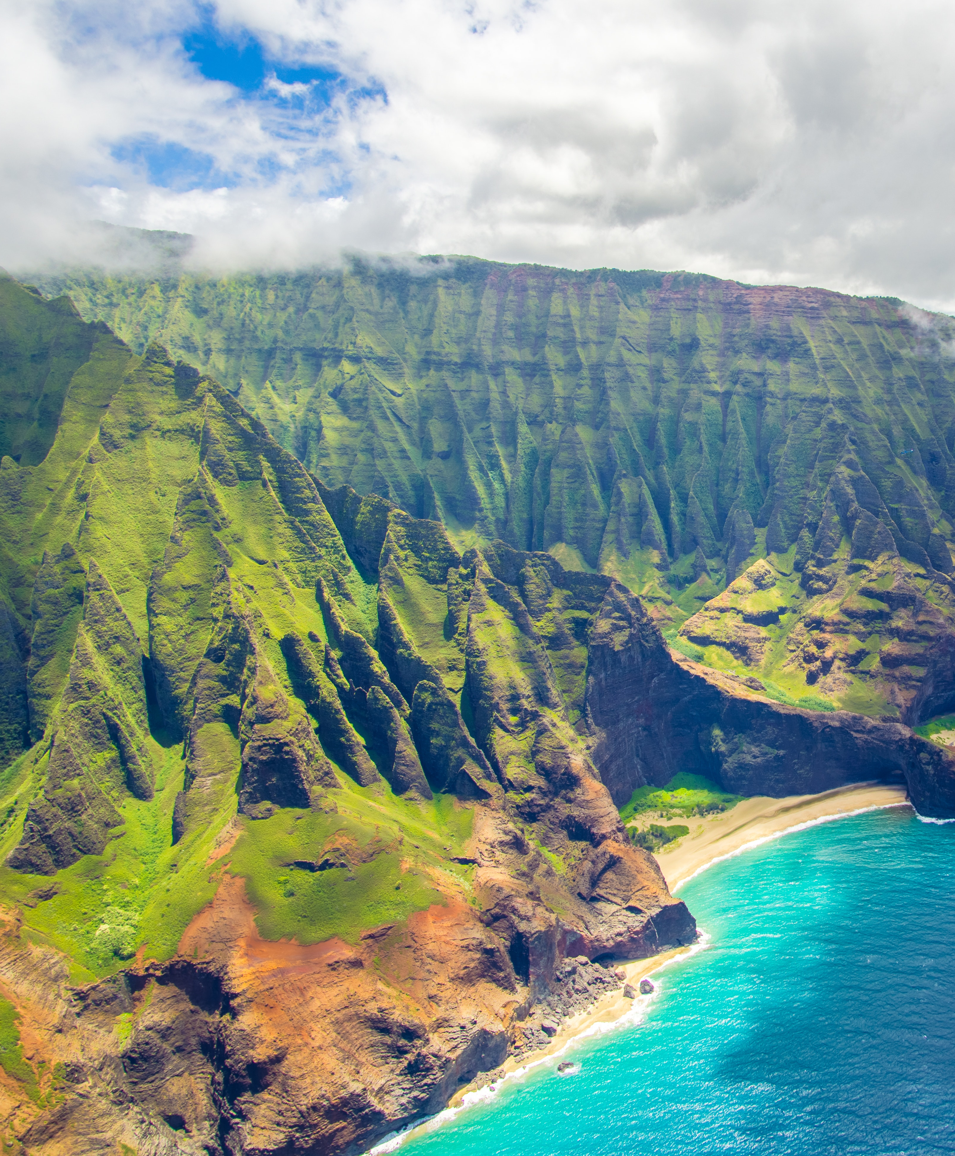
MOLOKAI
It is the fifth largest Island that make up the Hawaii.
Its known for its untouched natural landscapes and for having some of the highest cliffs in the world
Imagine the Hawaii of the past untouched beaches, no skyscrapers or stoplights.

Slide 8
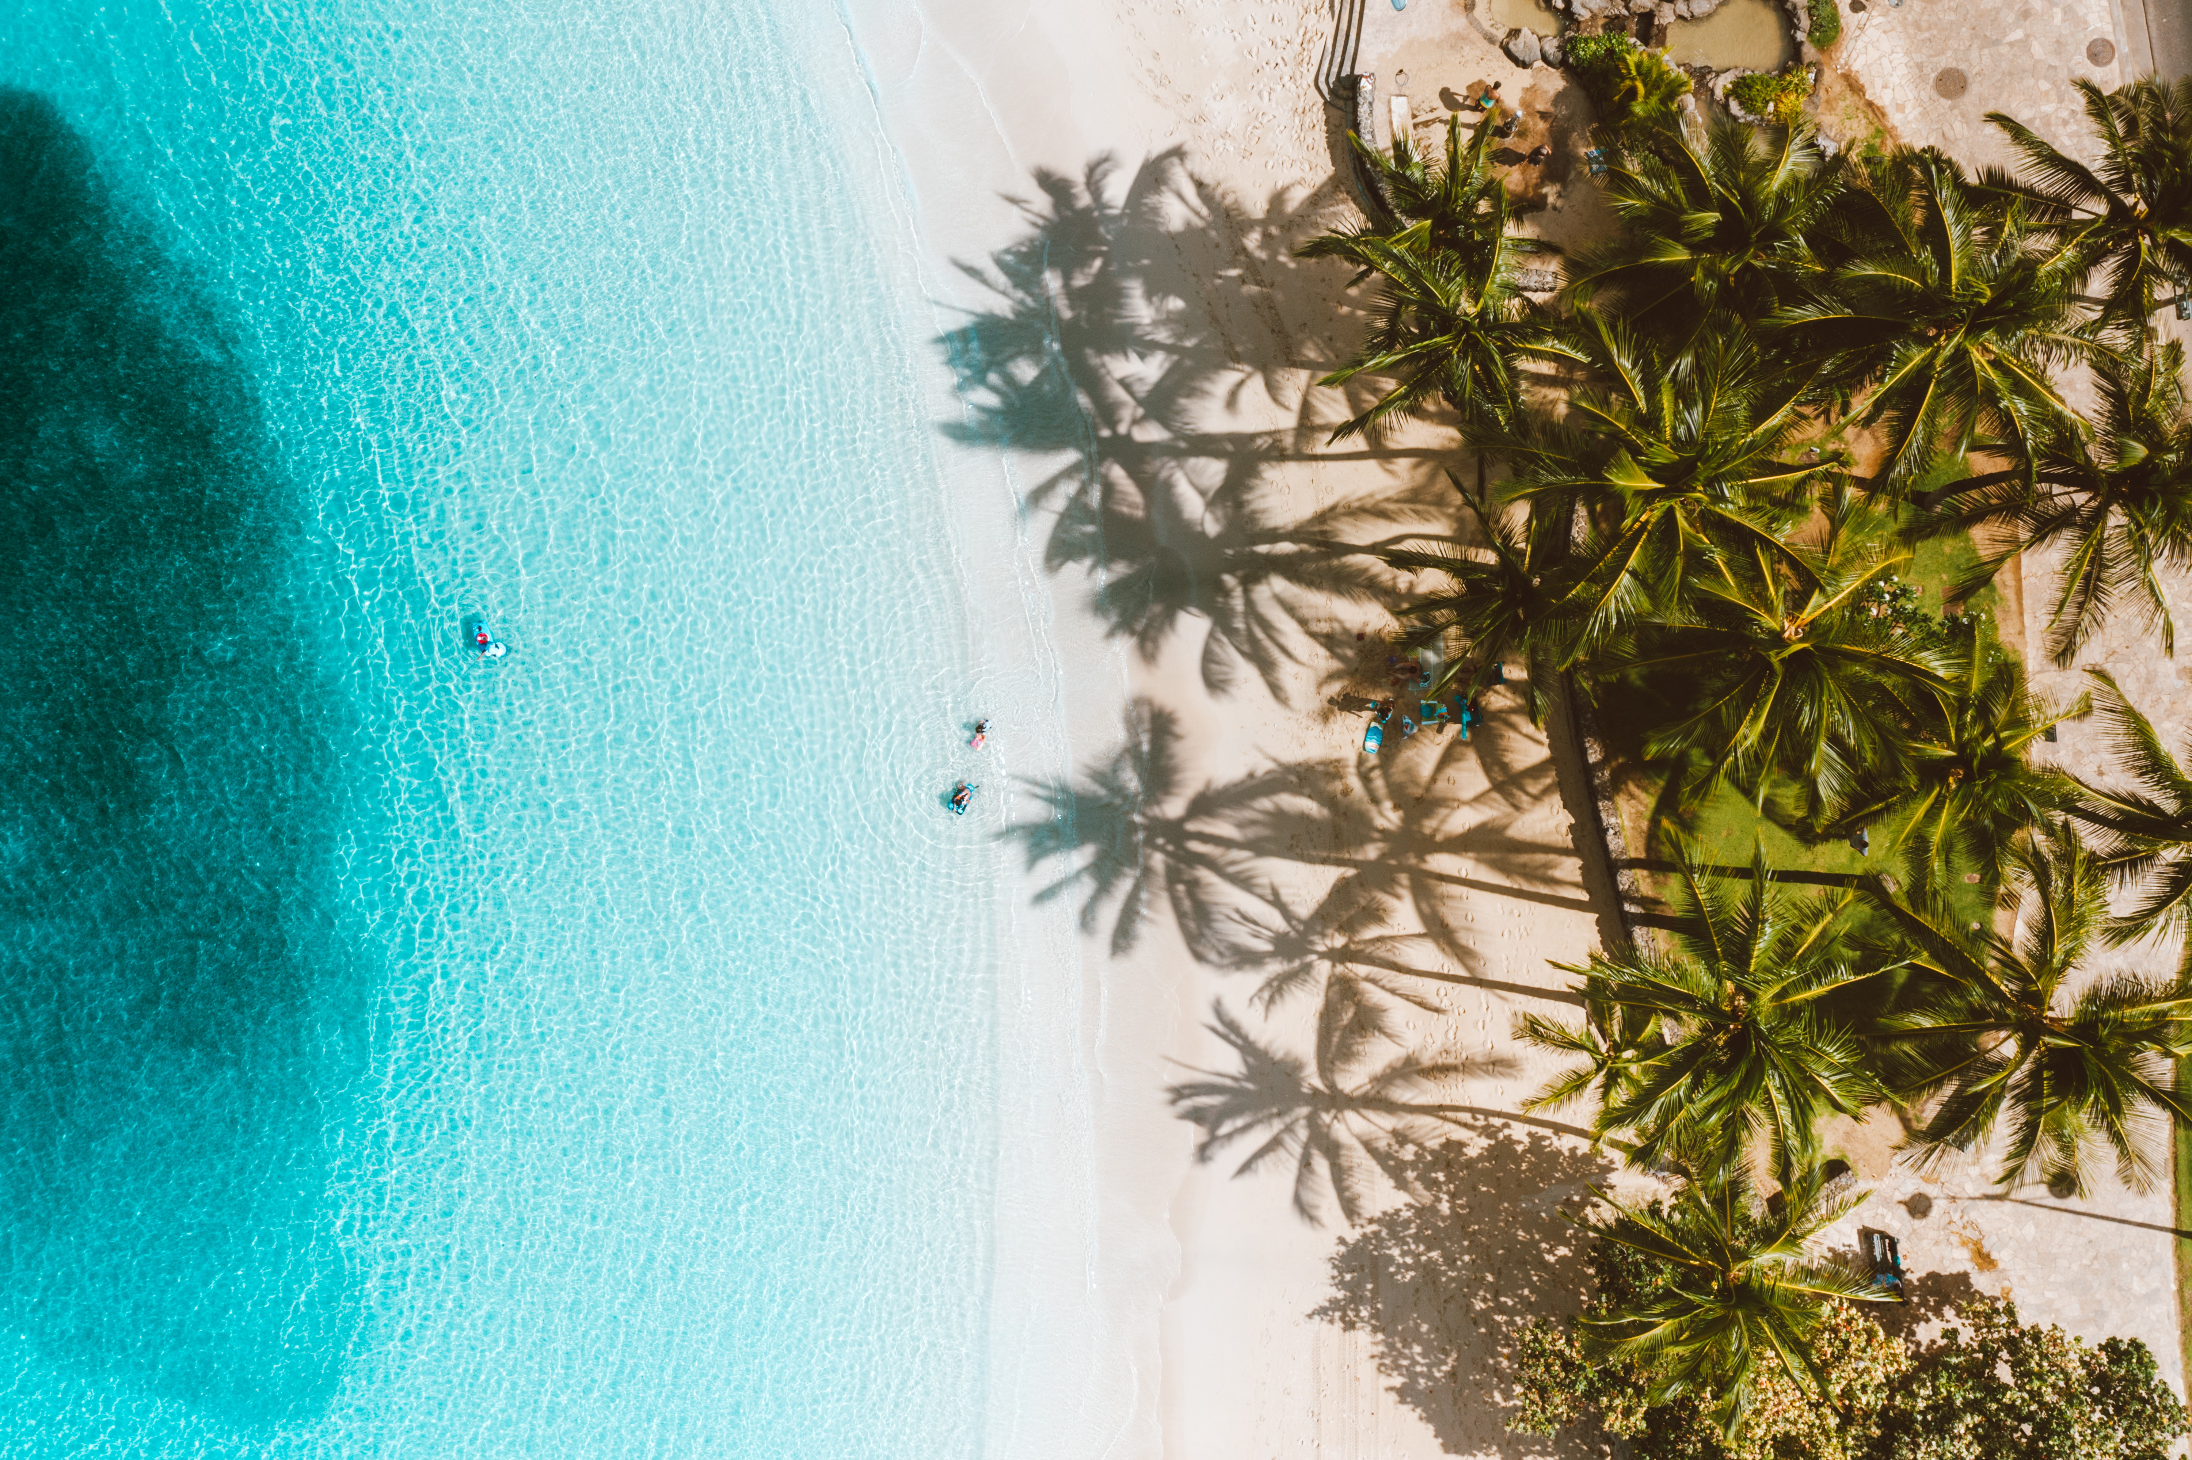
LANAI
Lanai is a roughly apostrophe-shaped island with a width of 18 miles (29 km) in the longest direction.
It can feel like two places. The first is found in luxurious resorts where visitors can indulge in world-class amenities. The other is found bouncing along the island's rugged back-roads in a 4-wheel drive exploring off the beaten path treasures like Keahi Kawelo (garden of Gods) and Po Lihua Beach.

Slide 9

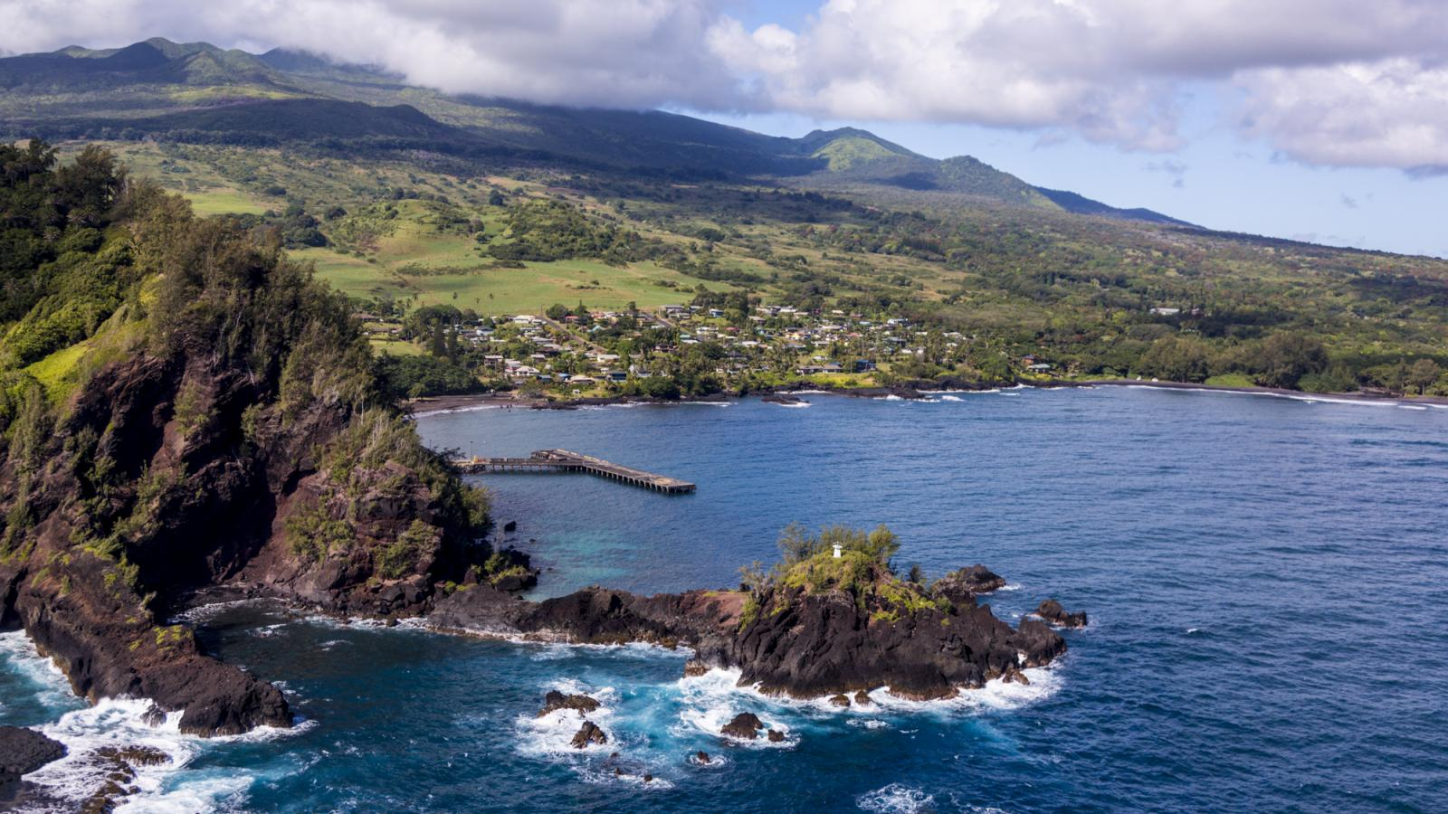

MAUI
The island of Maui is the second-largest of the islands of the state of Hawaii at 727.2 square miles (1,883 km²). Its nickname is "The Valley Isle," which describes its geography as a large valley between two dormant volcanoes — Haleakala in the east and Mauna Kahalawai in the west. Haleakala's name means "House of the Sun," and it's the largest dormant volcano in the world at 10,023 feet high, 4,000 feet deep, and 21 miles across its crater. Mauna Kahalawai, an eroded volcano, is referred to as the West Maui Mountains.

Slide 10
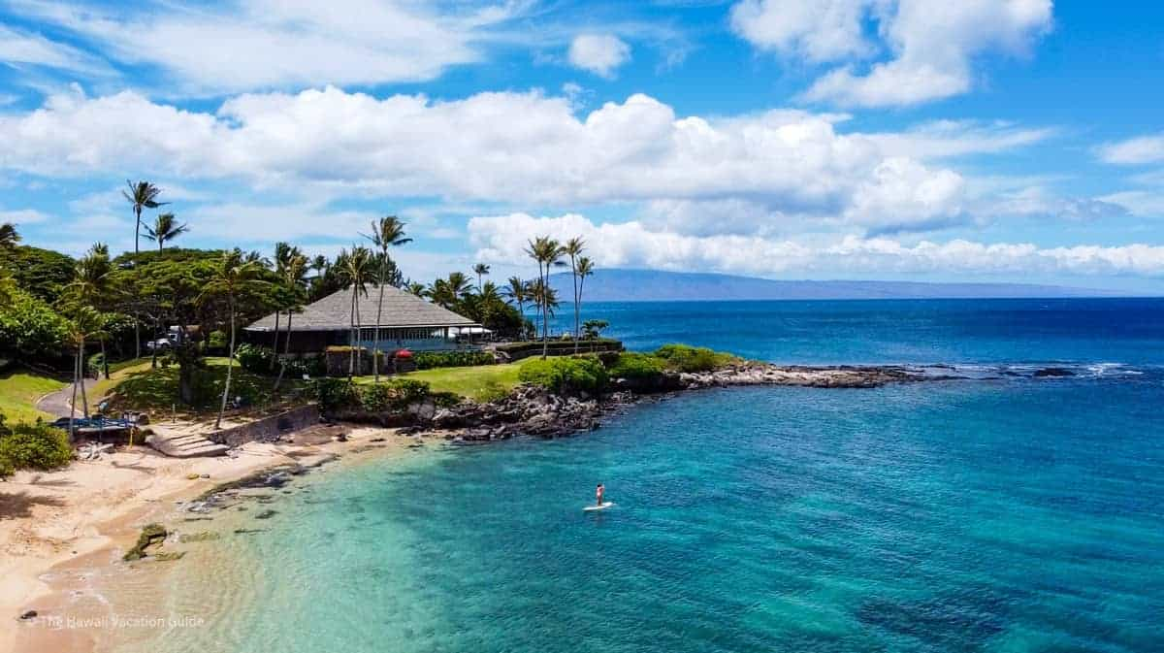
If only one day I have the fortune to visit this beautiful heaven, my life would be completed.

Slide 11
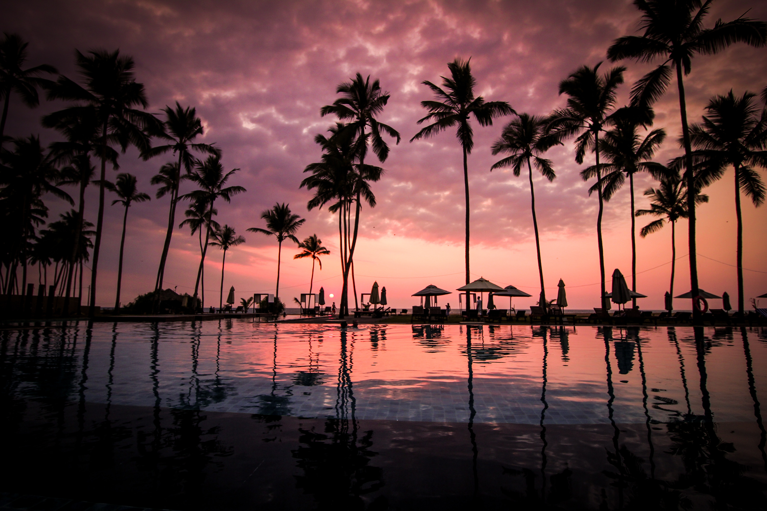
Thank you.
N ame – Taiba Ubaid class- M.A 1 year
Faculty no.- 22GGMSA108
Enroll. No. – GJ4473
Submitted to – Rashid sir

